Slide 1






Continues Integration Automation Using Jenkins
Copyright © 2017 Tech Mahindra. All rights reserved.
1

Slide 2



TABLE OF CONTENT
Continuous Integration
CI Architecture
Aspects of CI
Source Code Repository
Automated Build
Jenkins

Slide 3


Continuous Integration - Overview
Background:
Continuous
Integration (CI) is a fundamental best practice of modern software
development CI requires developers to integrate code into a shared repository several times a day. Each check-in is then verified by an automated build, allowing teams to detect problems early.
Overview:
Build automation in Jenkins achieved by running automated scripts (Batch / Ant / Maven) for projects.
Scripts for most of the common tasks is auto generated and requires just writing script for uncommon, complex tasks only.
Build for Windows, iOS, Android, Java (Ant, Maven, or Gradle), or Linux using the same domain-specific languages.
Live console view in the web with real time status of each build.
Easy customization - Edit in the web and leverage existing knowledge of popular script languages (Shell Script, Batch Script)

Slide 4
Continuous Integration - Benefits
Benefits:
Streamlined, consistent and reliable Builds.
Saves time
Easy to scale up or scale out build components across machines to get more build power
Reduced dependency on individual resources
Immediate Bug detection

Slide 5








Continuous Integration – Tools Recommended
Jenkins – Open source CI tool
Scripts Automation using Shell Scripts, Batch Scripts – Automating
using simple scripts
tasks
Build tools like Maven, Ant - Open source tools for managing build structure
▪
Subversion, CVS, Git - Capability to work with various configuration
management systems
Case Studies : CITI, Swiss Re, D+H, GE, ACRA, AT&T, Nissan, CMIC

Slide 6

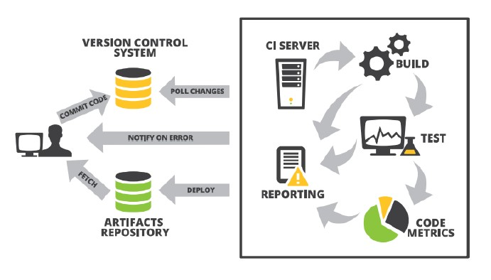
CI Architecture

Slide 7
Aspects of CI
Source Code Repository
A source code repository is a file archive and web hosting facility and file are viewed and accessed publicly or privately.
Tools: CVS, SVN, GIT
Build automation is the process of automating the creation of a software build and the associated processes including - compiling computer source code into binary code, packaging binary code, and running automated tests
Tools: Scripts, Ant, Maven
Automated Build
Continuous integration (CI) is the practice, in software engineering, of merging all developer working copies to a shared mainline several times a day
Tools: Jenkins
CI Server
Test automation is the use of special software (separate from the software being tested) to control the execution of tests and the comparison of actual outcomes with predicted outcomes
Tools: Selenium
Automated Tests
Automated
Deployment
Continuous Delivery (CD) is a software engineering approach in which teams keep producing valuable software in short cycles and ensure that the software can be reliably released at any time
Tools: Jenkins

Slide 8

Jenkins - Overview
Jenkins is an open source continuous integration tool written in Java programming language for testing and reporting on isolated changes in a larger code base in real time.
The software enables developers to find and solve defects in a code base rapidly and to automate testing of their builds.
CI is a development practice that requires developers/testers to integrate their work frequently into a shared repository several times a day.
Each integration is performed by automated build
Building / Testing of software projects continuously
Monitoring of externally executed jobs
Hudson was first released by Sun Microsystems in the year of 20025
Jenkins is a fork of a project called Hudson, which is trademarked by Oracle and is currently being developed parallel to Jenkins.

Slide 9

Jenkins - Feature List
Easy install, upgrade and configure.
Check out source code:
CVS, Subversion, Clear Case, Mercurial, Accurev, Perforce, Git
Perform builds using
Ant, Maven, shell script, NAnt
Record and publish results.
HTTP API.
Open Source and Commercial Tools integration:
Find Bugs, Cobertura, Emma
Plugin support, update centre, 400+ plugins
Authentication Using
LDAP, AD, Open ID, SQL
Testing using
Selenium, Sauce, Windmill
Master + slave nodes
Start Master-only, add slaves later
Slaves can be on different platforms
Allows build/testing on different OS

Slide 10


Jenkins - Installation
Pre-requisites:
To run Jenkins on a Windows / Linux machine need to install the Java 6/ 7 and above
Downloading Jenkins:
Download Jenkins war file from http://jenkins-ci.org/
Running Jenkins:
Execute war file using C:/>java –jar jenkins.war
(OR)
Install tomcat and deploy the jenkins.war file in [Tomcat]/webapps folder and run the tomcat server by running the file in [tomcat]/bin/startup.bat file
Open the Jenkins browser using URL in any browser http://localhost:8080/jenkins

Slide 11


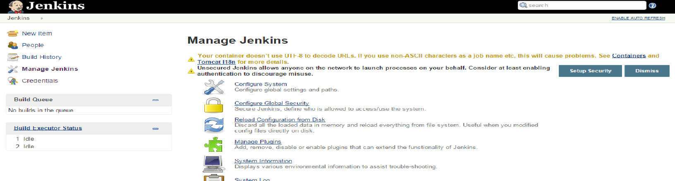
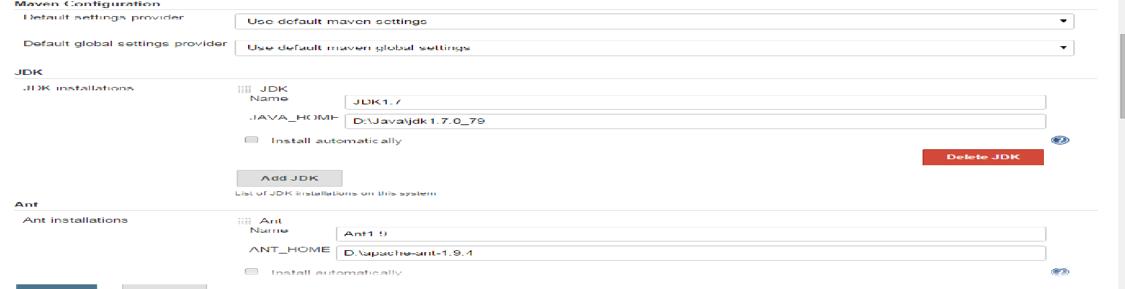
Jenkins - Configuration
Manage Jenkins page - Central one-stop-shop for all Jenkins configuration. From this page configure Jenkins server, install and upgrade plugins, keep track of system load, manage distributed build servers can be performed.
Configure Jenkins screen – Configuring configurations JDK, Ant, Maven, Global Properties, Notifications, Git and security options.

Slide 12

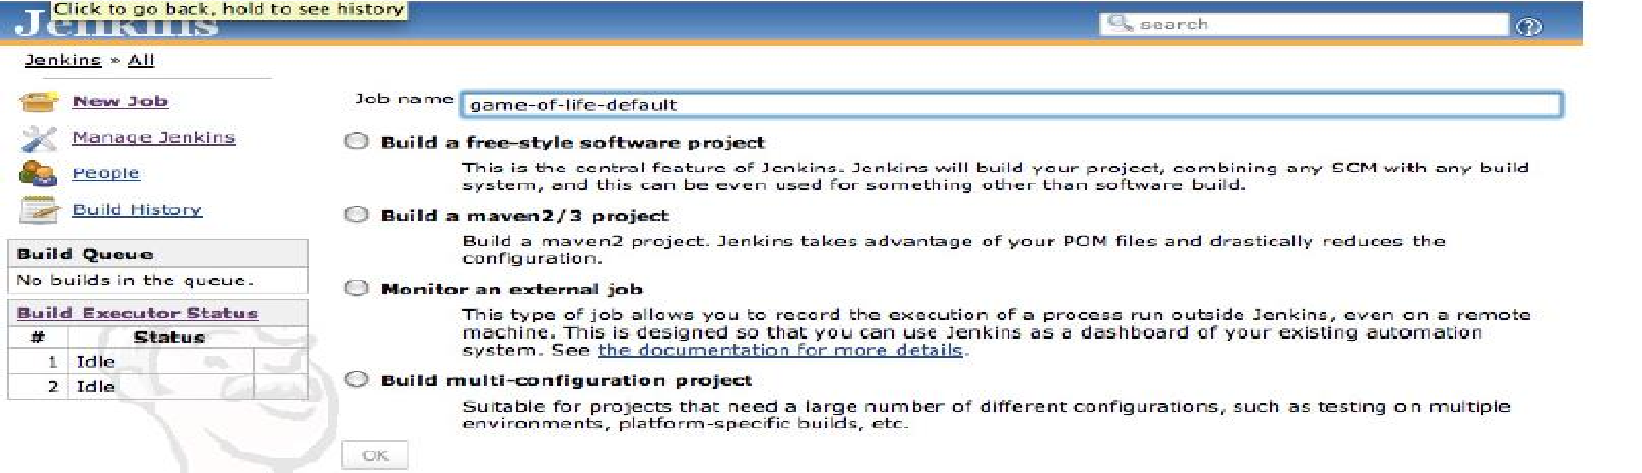
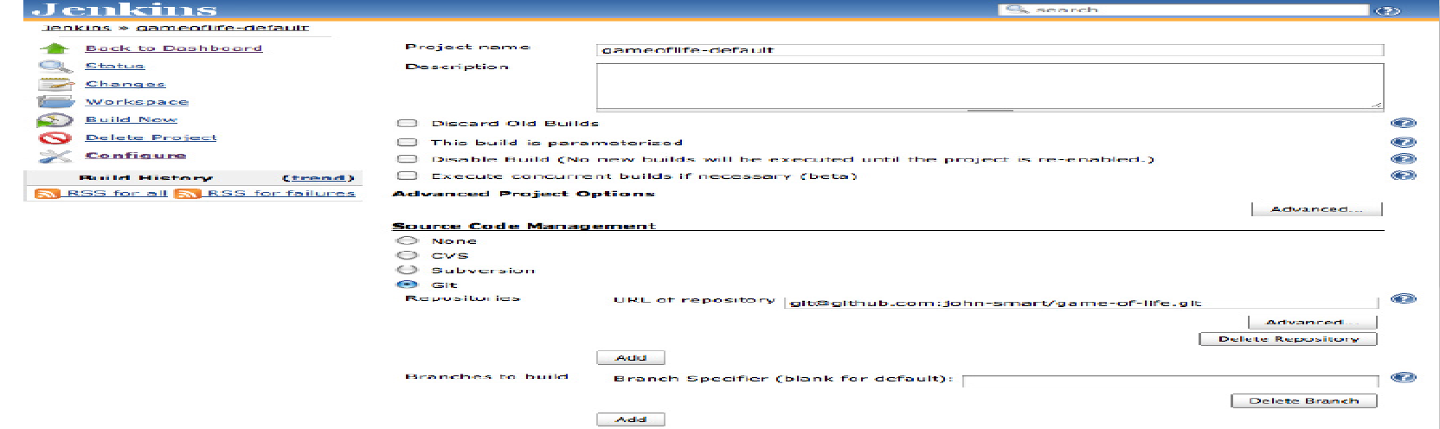
Jenkins - Setting First Job
First Job - Build jobs are at the heart of the Jenkins build process
Configure Jenkins Job- Screen to configure the job where to get the source code and how to execute scripts in sequential process.

Slide 13

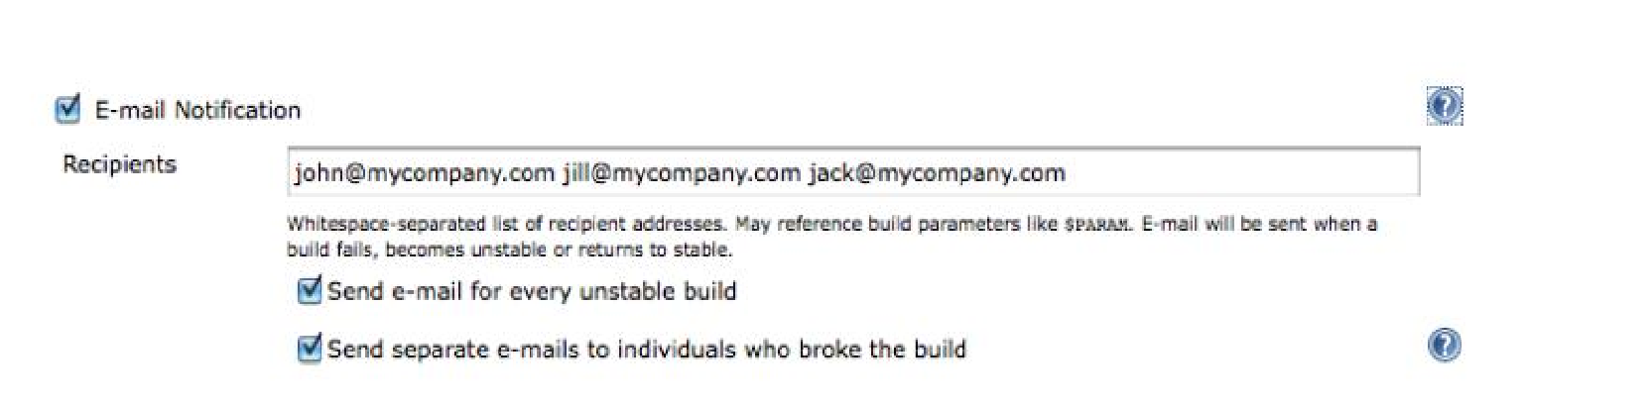
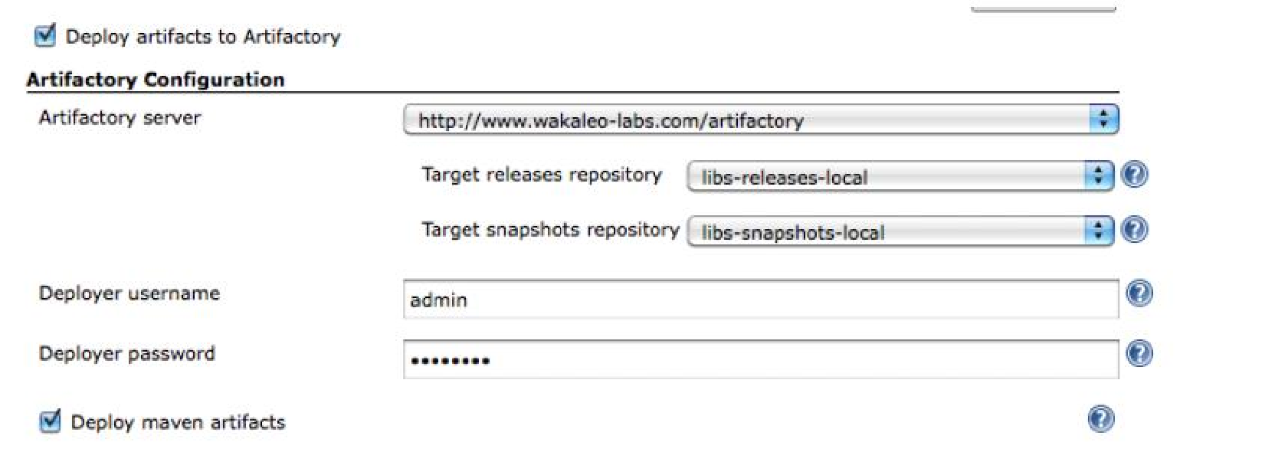
Jenkins – Configurations (Email)
E-Mali configuration
Artifactory Configuration

Slide 14

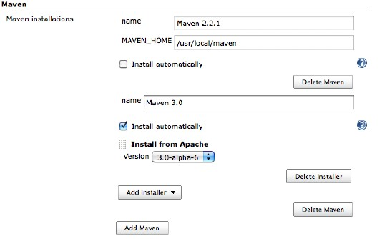
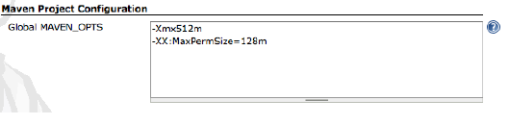
Jenkins – Configurations (Build Tools)
Build tools are the bread-and-butter of any build server, and Jenkins is no exception. Jenkins supports three principal build tools: Ant, Maven, and the basic shell-script
Maven:

Slide 15

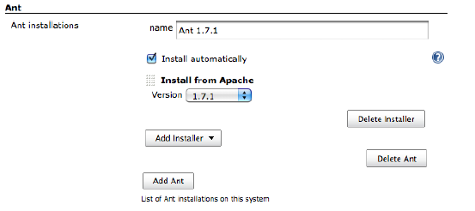
Jenkins – Configurations (Build Tools)
Build tools are the bread-and-butter of any build server, and Jenkins is no exception. Jenkins supports three principal build tools: Ant, Maven, and the basic shell-script
Ant:

Slide 16
TABLE OF CONTENT
Jenkins – Advanced Topics
Automated Deployment
Distributed Builds
Tools and Acceleratos

Slide 17
Jenkins - SonarQube Process Flow
Install Sonar and Sonar Runner
Create Users and Groups in Sonar server using administration login
Assign projects to the sonar by using Sonar runner
Assign Rules for the project
Assign Users and Groups for the project to access
Sonar
Install Jenkins
Add Sonar plugin in Jenkins plugin
Create people OR assign LDAP to the Jenkins
Configure Sonar and Sonar Runner in Jenkins
Assign jobs to the people for execution
Create Job and assign Sonar runner / ANT / Maven task to execute sonar rules
Jenkins
Login to Sonar server with user details
View the project code review report in Sonar Dashboard
Sonar Reports

Slide 18

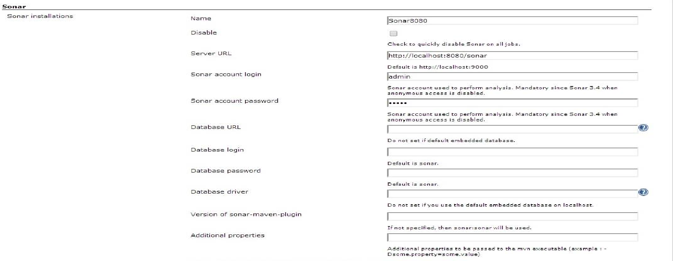
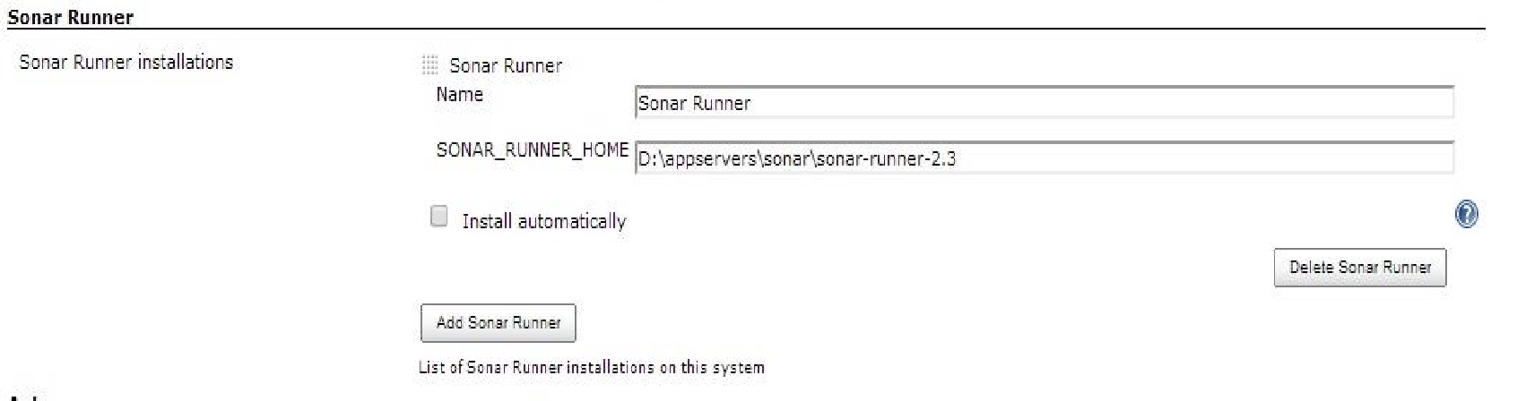
Jenkins - SonarQube Configurations and Running
Sonar Server Configuration Details where the SonarQube is running from Jenkins Configuration
Sonar Runner Configuration where the Sonar Runnier is available from Jenkins Configuration

Slide 19

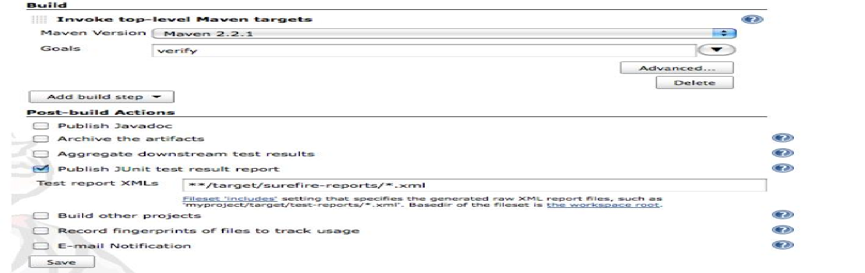
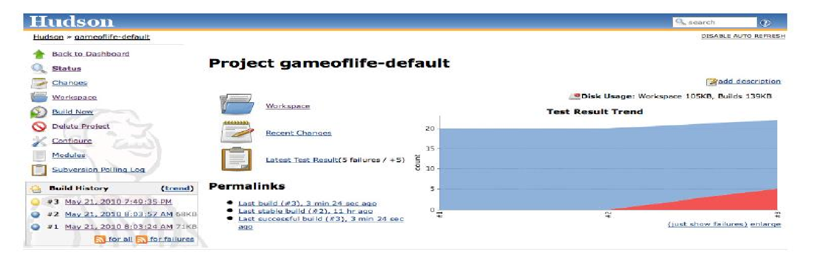
Jenkins – Testing Configuration
Automated Unit Testing
Testing Report

Slide 20

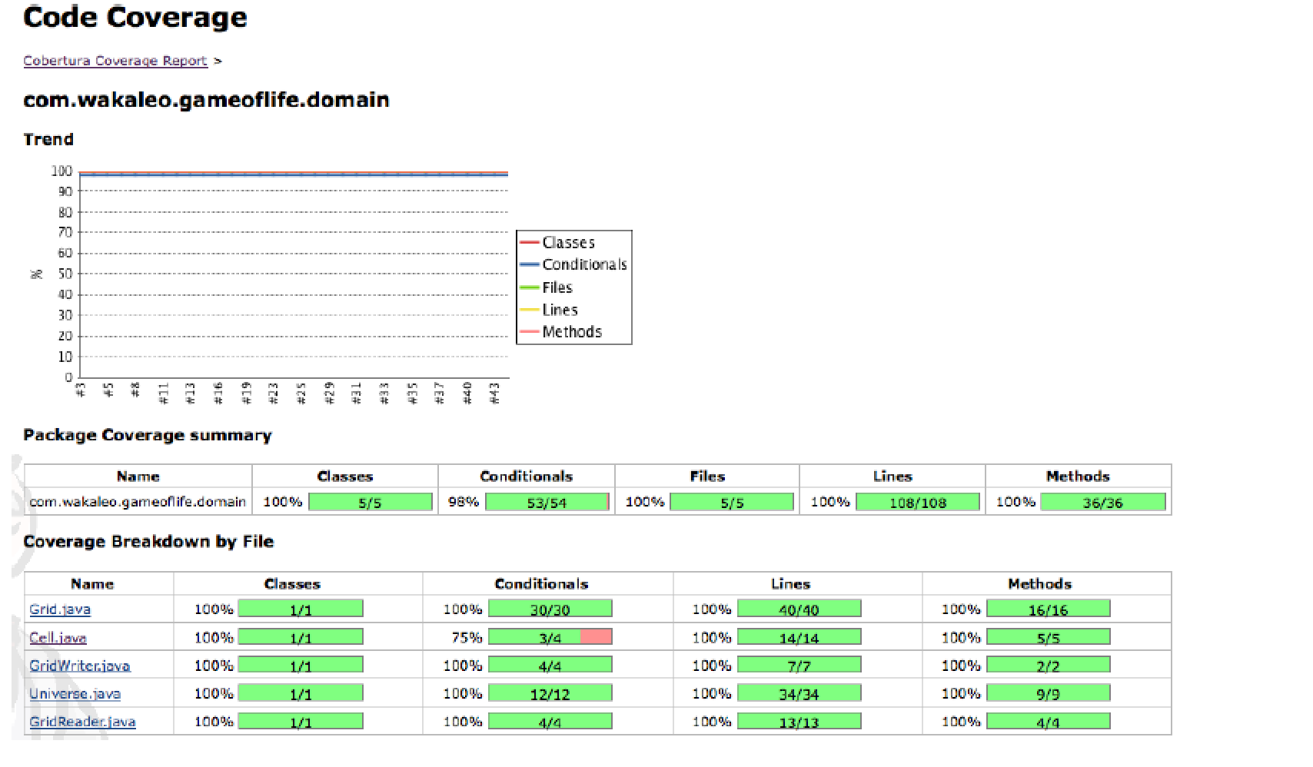
Jenkins - Code Coverage
Code Coverage Report:

Slide 21

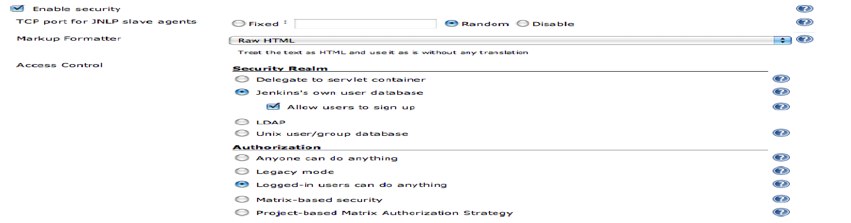
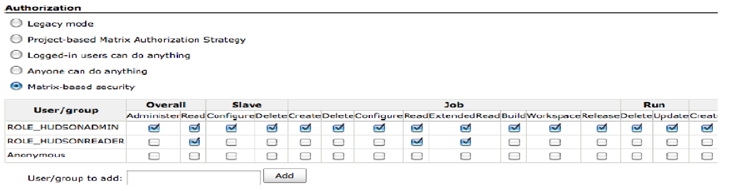
Jenkins - Security
The first section, Security Realms, determines where Jenkins will look for users during authentication, and includes options such as using users stored in an LDAP server, using the underlying Unix user accounts:
Authorization:

Slide 22
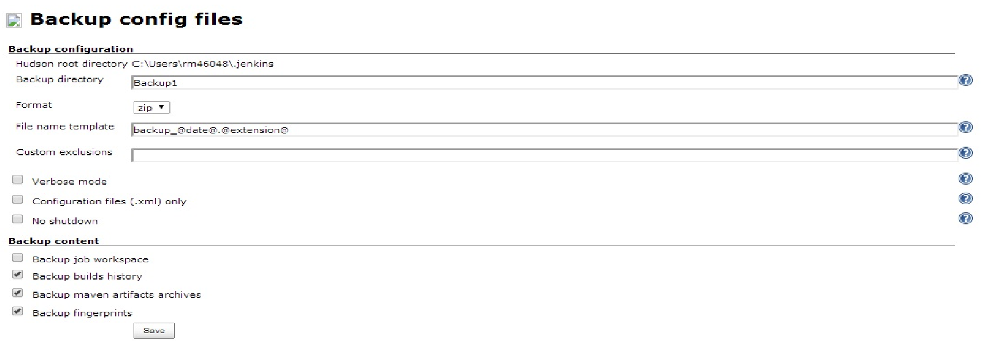
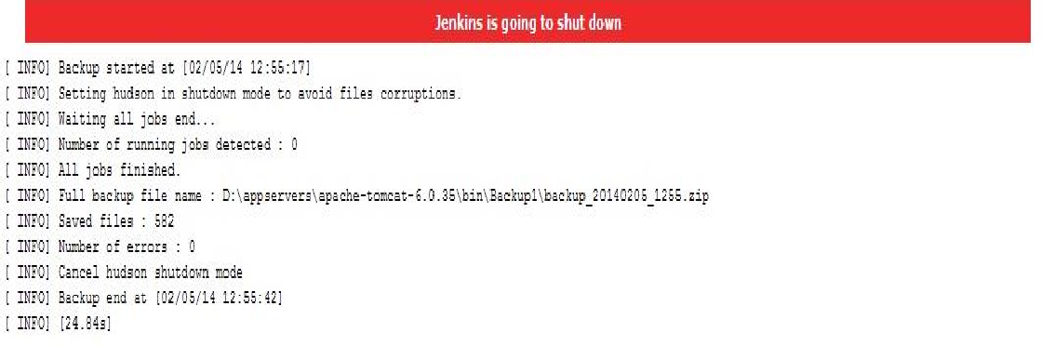
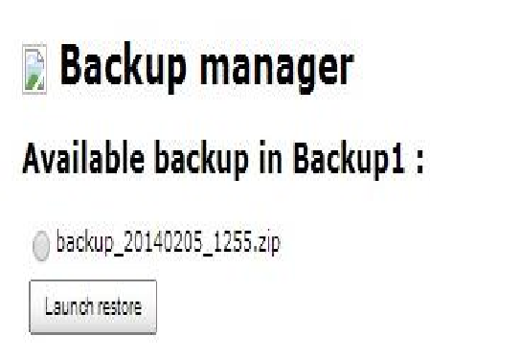
Jenkins - Backup
Backup Configuration
Options for Backup
Backup and Restore options

Slide 23

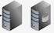


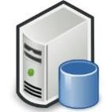



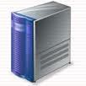

Automated Deployment
Test Environment
QA
Environment
Production Environment
Customers
Deploy
Deploy
Deploy
Latest Label
Jenkins Sonar Plugin
Feedback from Customers
Feedback from Server
Feedback from Server
Sonar Database
Sonar
Server
Project Manager
Configuration Management
Alerts & Notifications
Commit Changes
Developer
Developer

Slide 24
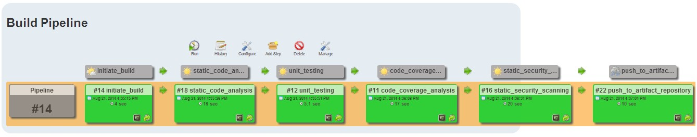
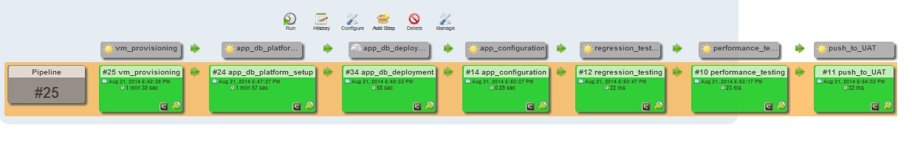
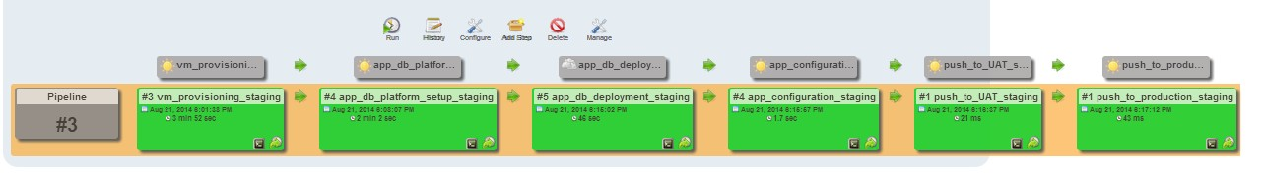
Automated Deployment – Build Pipeline
Deployment Pipeline for Test Environment
Deployment Pipeline for Staging Environment
UAT
UAT

Slide 25

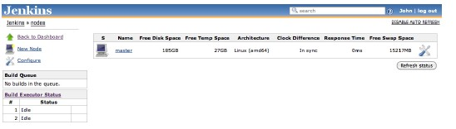
Jenkins - Distributed Builds
Jenkins uses a master/slave architecture to manage distributed builds.
In a nutshell, the master’s job is to handle scheduling build jobs, dispatching builds to the slaves for the actual execution, monitor the slaves and recording and presenting the build results.
Even in a distributed architecture, a master instance of Jenkins can also execute build jobs directly.
The job of the slaves is to do as they are told, which involves executing build jobs
dispatched by the master.

Slide 26

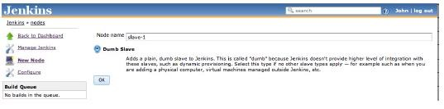
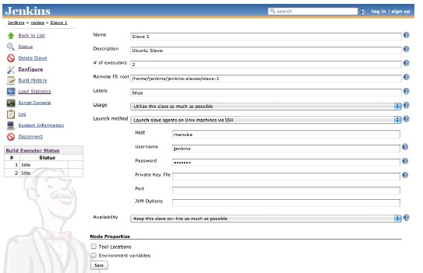
Jenkins - Distributed Builds (Contd..)
Several different strategies when it comes to managing Jenkins slave nodes, depending on target operating systems and other architectural considerations. The following are the different strategies.
Master starts the slave agents via SSH
Starting the slave agent manually using Java Web Start
Installing the slave agent as a Window service
Starting the slave agent directly from the command line on the slave machine from the command line

Slide 27

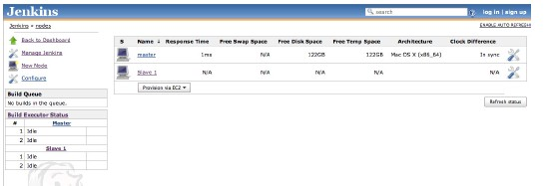
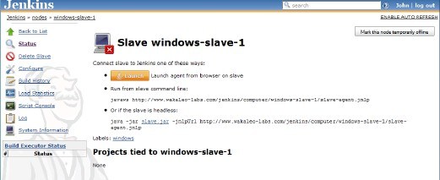
Jenkins - Distributed Builds (Contd..)

Slide 28






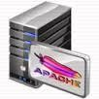
Jenkins - Master Slave Architecture
Public Repositories
CVS
Others
SVN
GIT
Mercurial
Users
Configuration Management Tools
Web Server / HA proxy with Virtual Web sites
Public
Repository - The third party artifacts
Jenkins Slave1
Snapshot Repository - Artifacts for dev and int. testing
Nexus / Artifactory
Jenkins Master
Sonar
Jenkins Slave2
Release
Repository Release signed off by QAT team.
Code Quality Reports
Maven / Ant

Slide 29

Tools and Accelerators
M-IDE : Developer Workbench
M-CI : CI Workbench
Configuration Management
Subversion, CVS
Build Management
Maven for Large projects
Ant for Smaller projects
Code Quality
PMD, CheckStyle, FindBugs using Developer IDE
Sonar using Developer IDE and a centralized
Sonar Server
Unit Testing
Unit Testing
EclEmma (Code Coverage)
eCobertura (Code Coverage)
Continuous Integration
Jenkins
Configuration Management
Subversion
CVS
Project Structure and Build Management
Maven
Code Quality Assessment
Sonar
Test Automation and Execution
JUnit, Selenium, TPTP Test Cases
EMMA for Code Coverage
Defect Tracking
Bugzilla
M-TEST : Tester Workbench
Reusable Components
Test Planning
TPTP for Test Case Suite Management
Test Case Preparation and Execution
Selenium , TPTP, TestNG
WebLoad and JMeter for Load Testing
TPTP for Code Profiling
Defect Tracking
Bugzilla
Exception Handling and Logging
LDAP Integration, Email Integration
Document Management – Jackrabbit
Barcode Generator, Captua Generator
Ehcache + Terracotta for cache distribution
Image Scanner, Image Viewer – Java Applet
MQ crusting scripts on Glass Fish Server.
Free lance calendar
QoS Aids
Reference Implementations
Architecture Review Templates, Capacity Planning Templates, High Availability solutions, Performance Engineering Methodology and Tools, Security Assessment
Agile Development Templates
Spring-Hibernate, JSF-Spring-Hibernate, GWT-Spring- Hibernate LDAP Integration
jBPM and BRMS, Mule

Slide 30
Thank You
Disclaimer
Tech Mahindra, herein referred to as TechM provide a wide array of presentations and reports, with the contributions of various professionals. These presentations and reports are for informational purposes and private circulation only and do not constitute an offer to buy or sell any securities mentioned therein. They do not purport to be a complete description of the markets conditions or developments referred to in the material. While utmost care has been taken in preparing the above, we claim no responsibility for their accuracy. We shall not be liable for any direct or indirect losses arising from the use thereof and the viewers are requested to use the information contained herein at their own risk. These presentations and reports should not be reproduced, re-circulated, published in any media, website or otherwise, in any form or manner, in part or as a whole, without the express consent in writing of TechM or its subsidiaries. Any unauthorized use, disclosure or public dissemination of information contained herein is prohibited. Unless specifically noted, TechM is not responsible for the content of these presentations and/or the opinions of the presenters. Individual situations and local practices and standards may vary, so viewers and others utilizing information contained within a presentation are free to adopt differing standards and approaches as they see fit. You may not repackage or sell the presentation. Products and names mentioned in materials or presentations are the property of their respective owners and the mention of them does not constitute an endorsement by TechM. Information contained in a presentation hosted or promoted by TechM is provided “as is” without warranty of any kind, either expressed or implied, including any warranty of merchantability or fitness for a particular purpose. TechM assumes no liability or responsibility for the contents of a presentation or the opinions expressed by the presenters. All expressions of opinion are subject to change without notice.
Copyright © 2015 Tech Mahindra. All rights reserved.

Slide 31
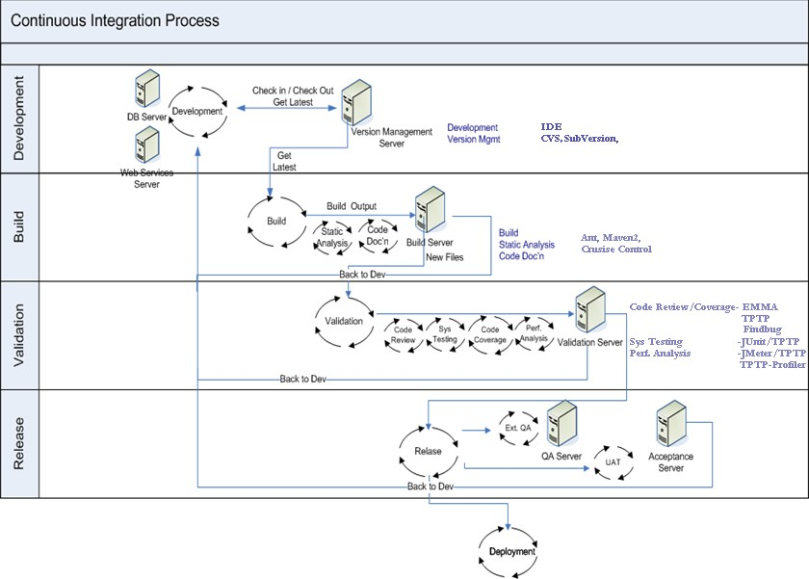
CI Workbench Open Source Tools

